Slide 1
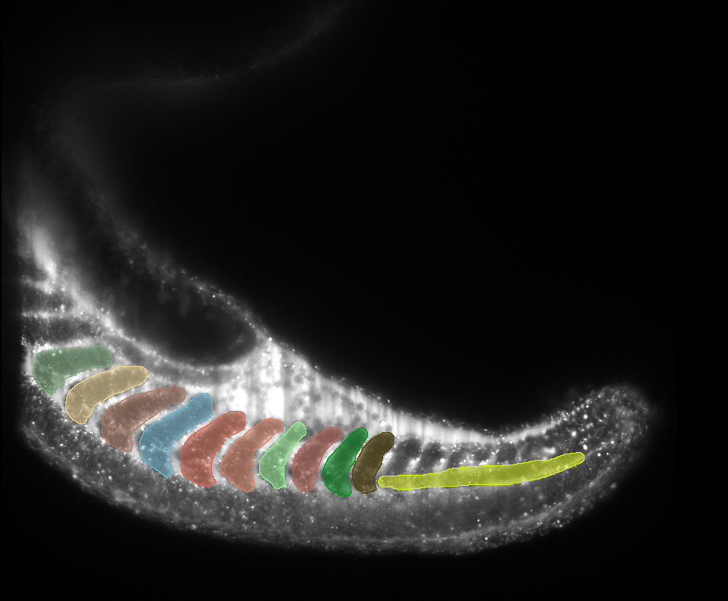
Automatic Image Segmentation of Light-Sheet Zebrafish Scans
MICROBS Lab
Supervising Professor : Selman Sakar
Supervising TA : Artur Krzysztof Banach
School of Engineering MICROBS
Aly Elbindary

Slide 2
Outline
Background & Objectives
Methodology
Results
Discussion

Slide 3
Background & Objectives

Slide 4
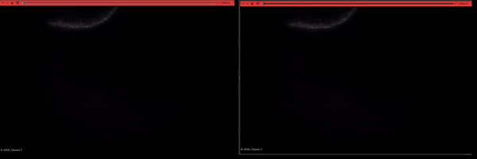
Goals & Motivation
What do we want to achieve? Why?

Slide 5
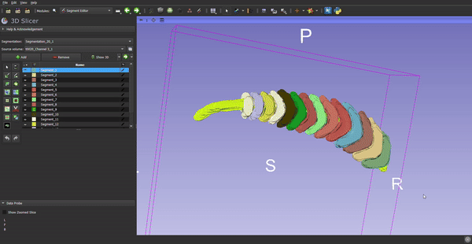
Goals & Motivation
What do we want to achieve? Why?

Slide 6
Methodology

Slide 7
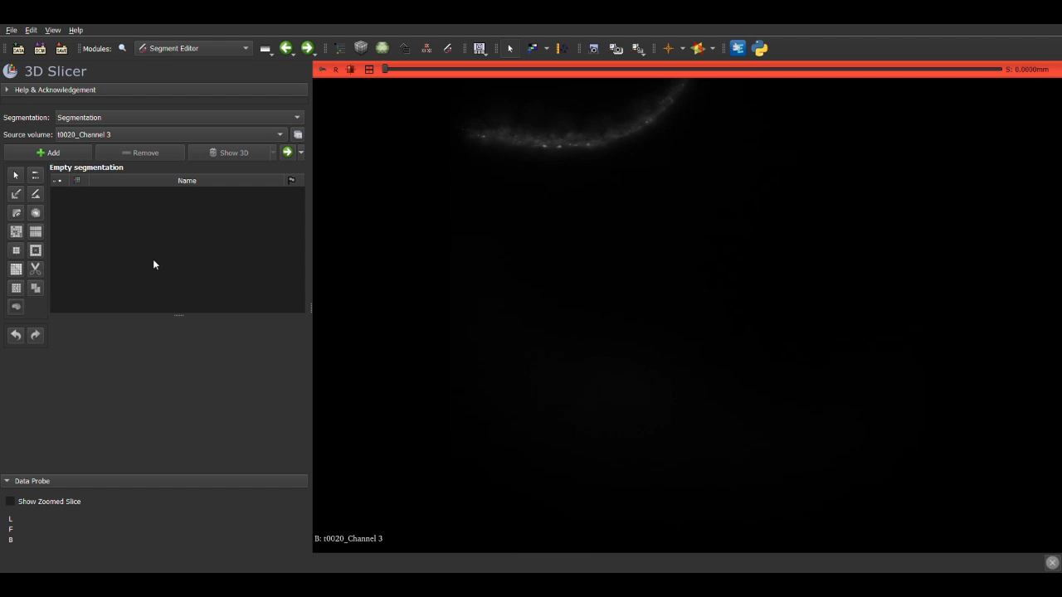
Methodology
Manual Segmentation

Slide 8
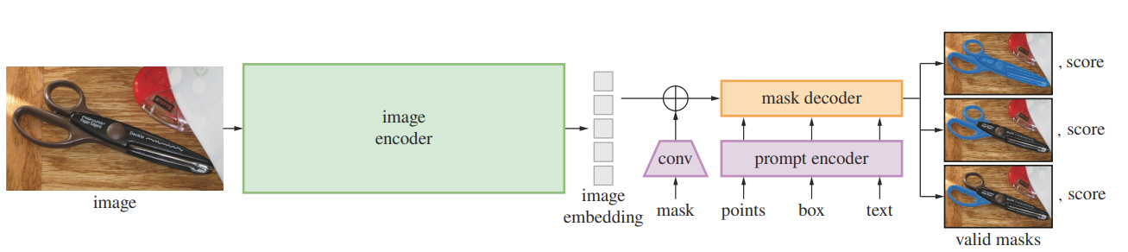
Methodology
Automatic Segmentation – Introduction to SAM
Segment Anything Model (SAM) – Architecture Overview [5]

Slide 9
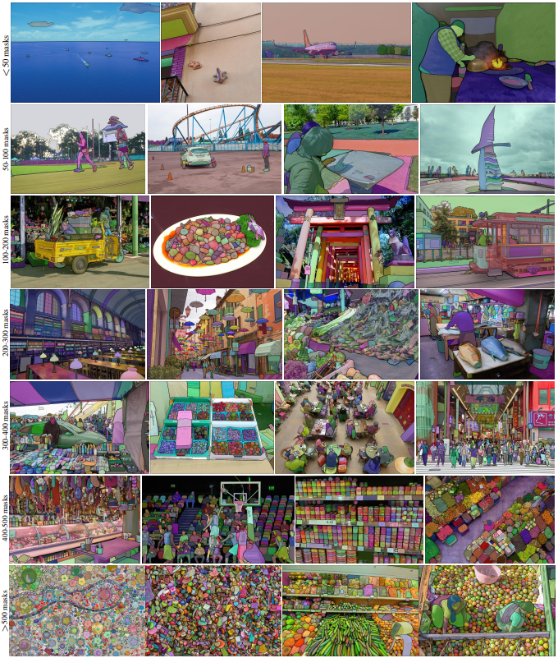
Methodology
Automatic Segmentation – Introduction to SAM
Example images with overlaid masks generated by SAM [5]

Slide 10
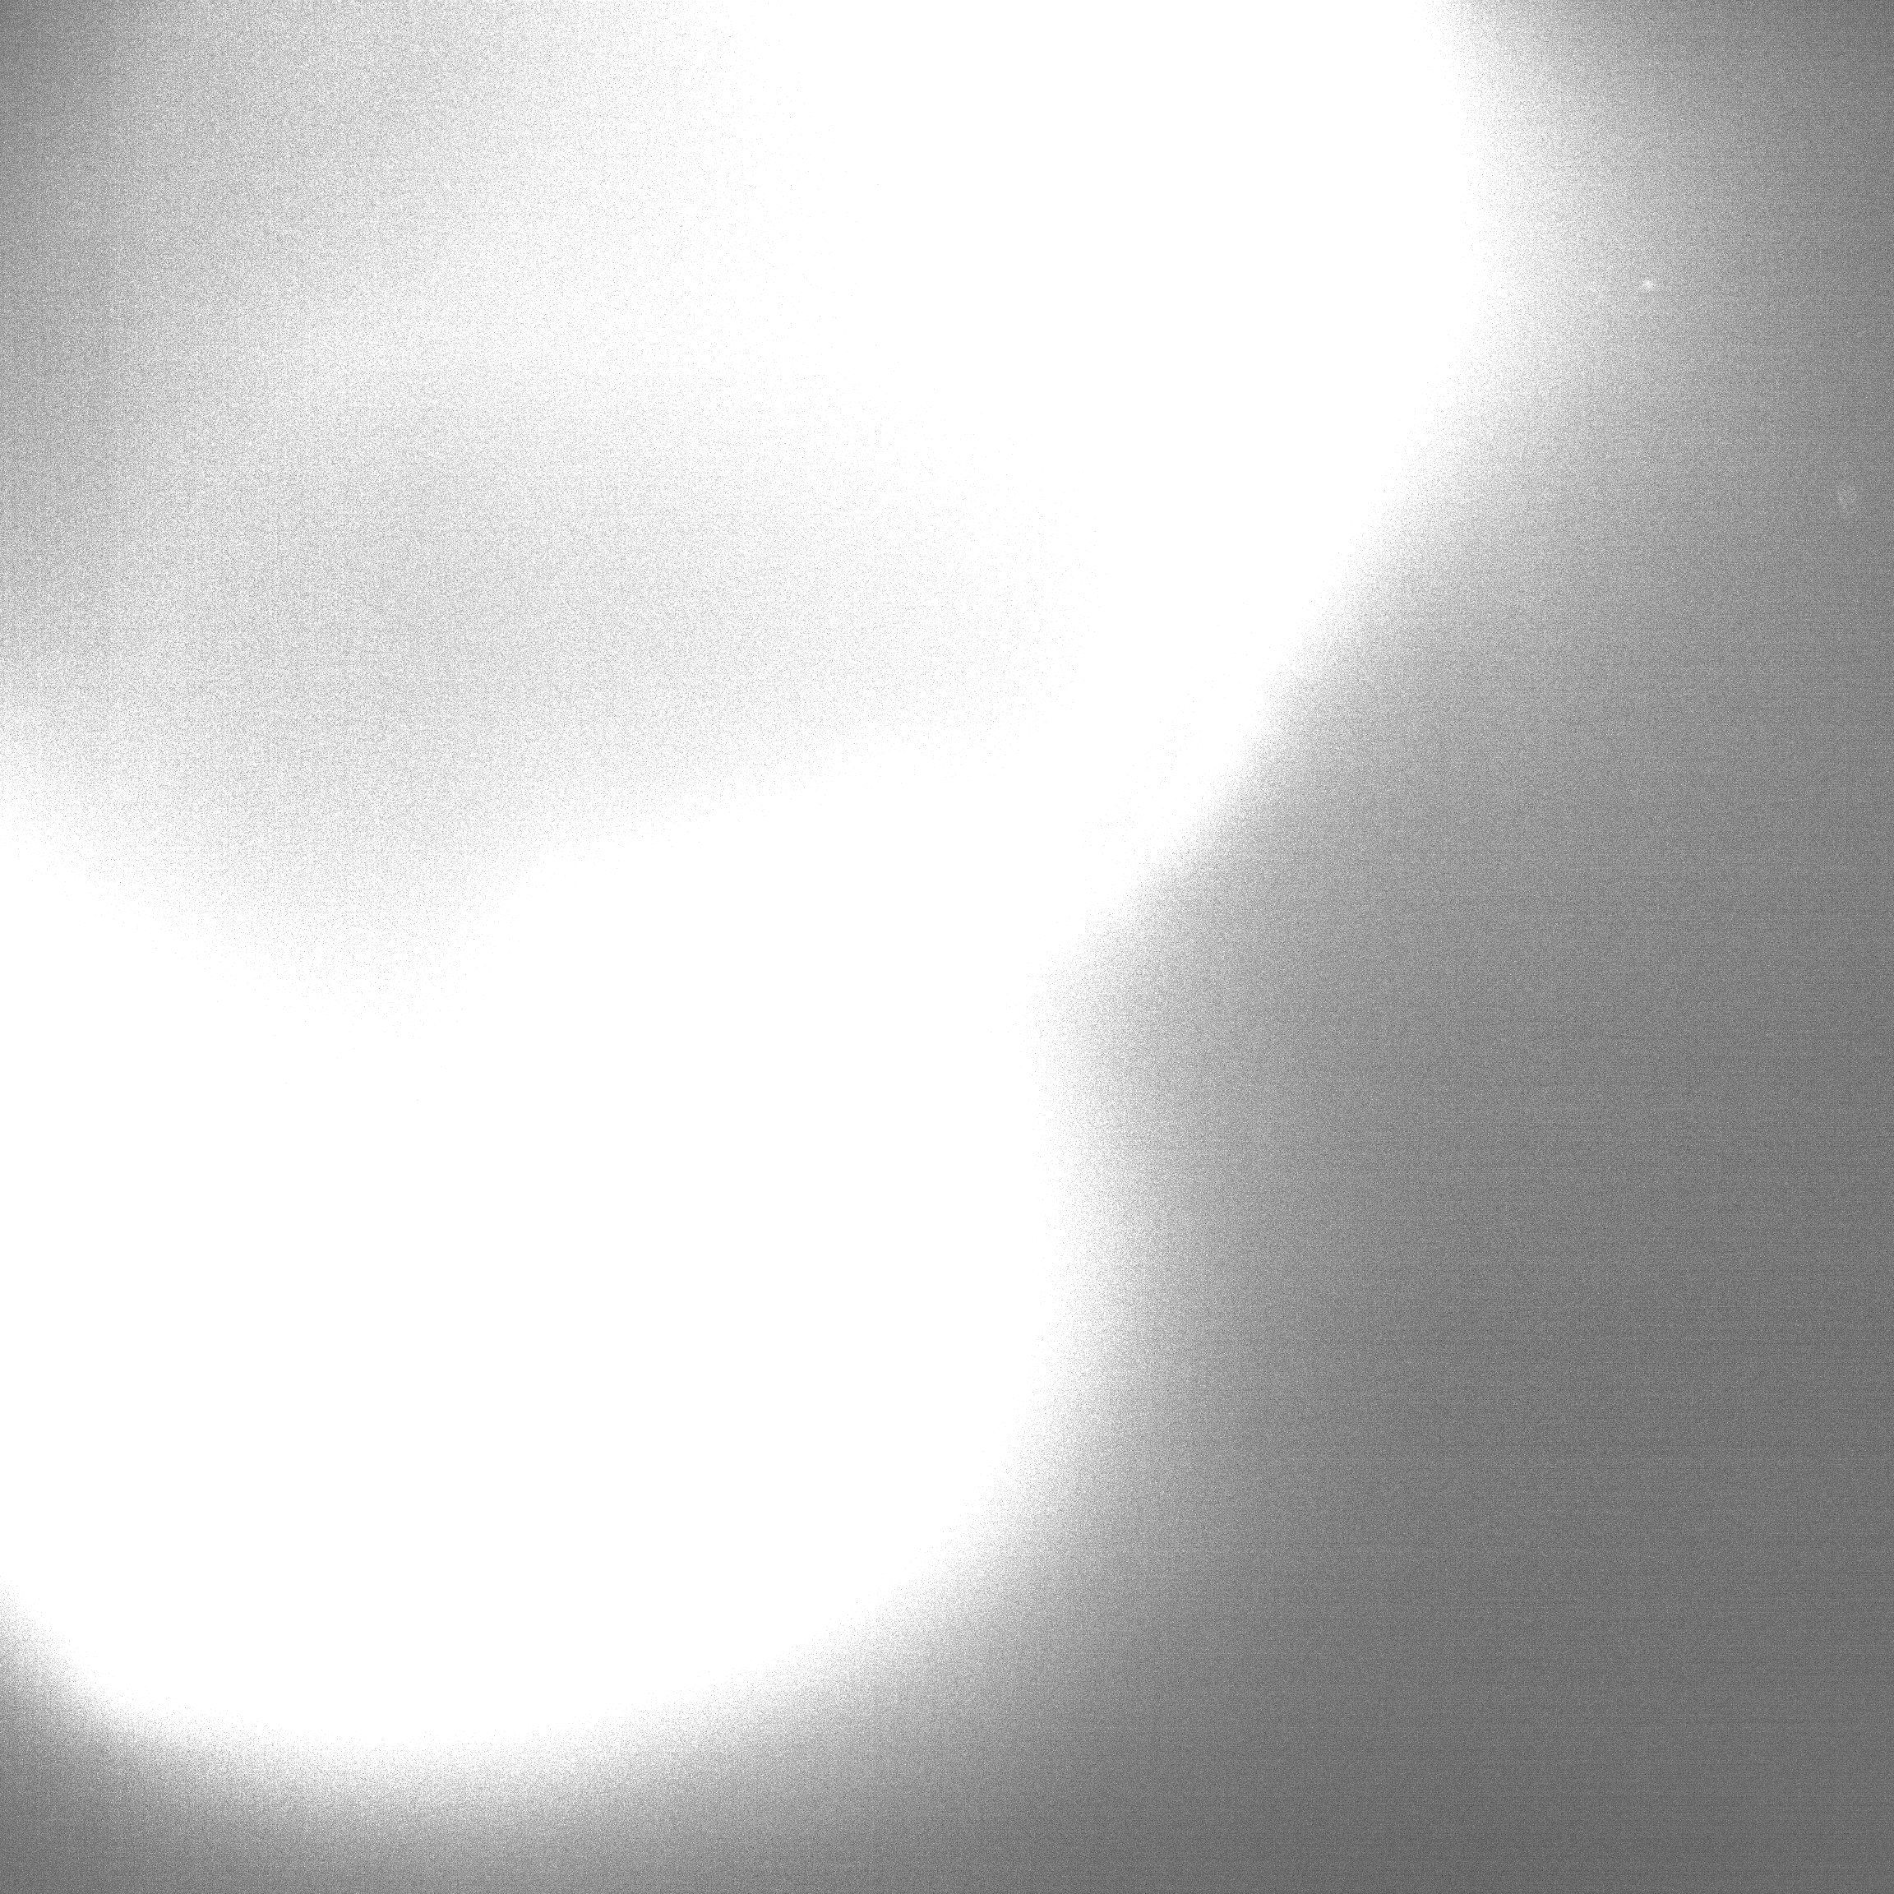
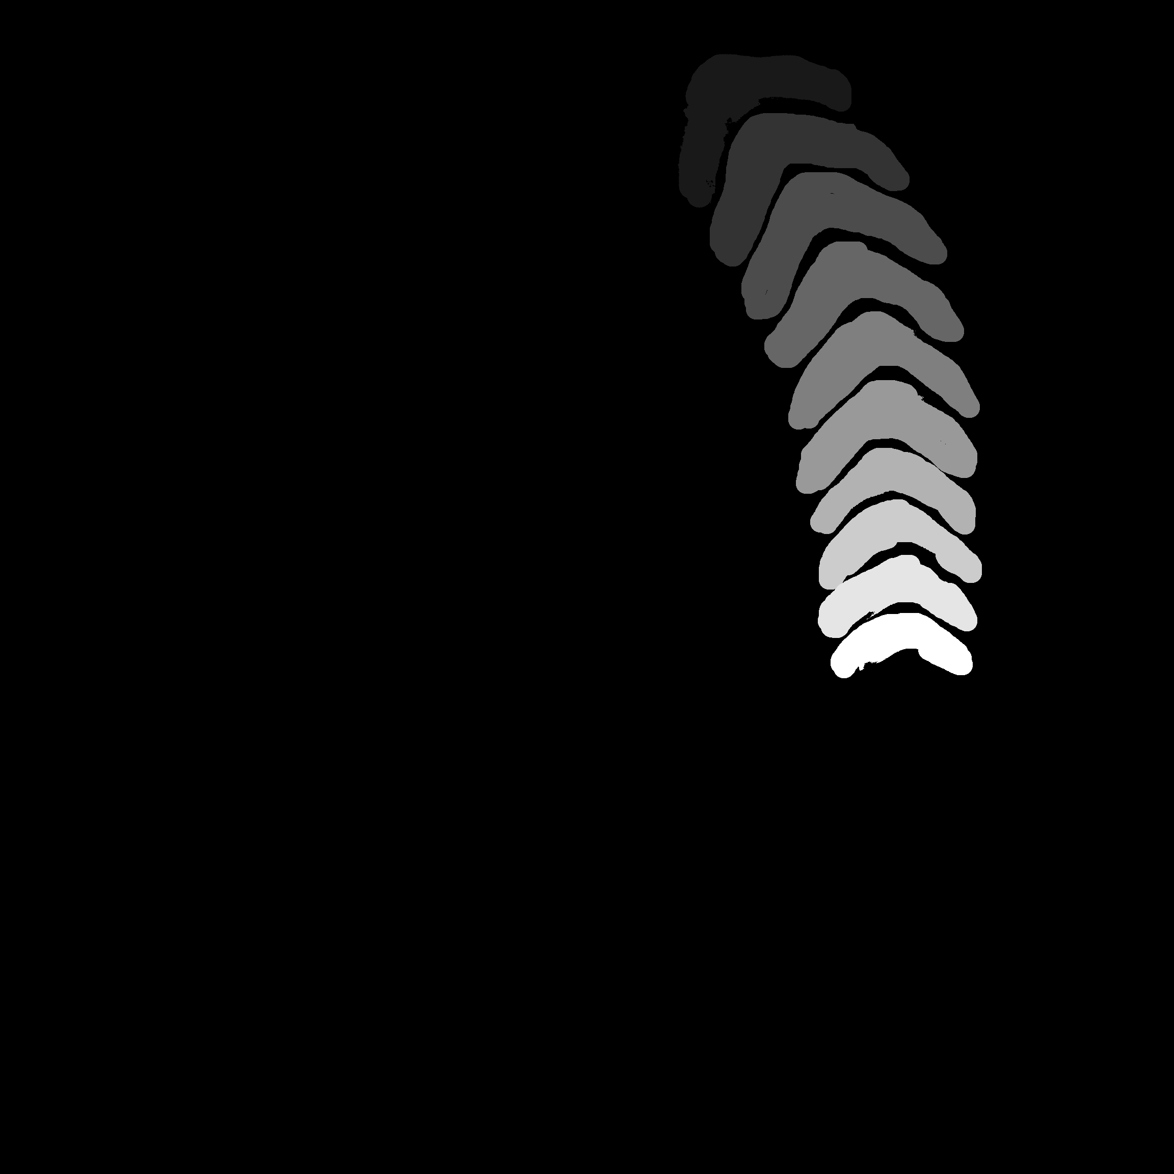
Methodology
Raw Data Adaptation
Raw Zebrafish Frame Loaded Without Adaptation
Raw Mask Frame Loaded Without Adaptation

Slide 11
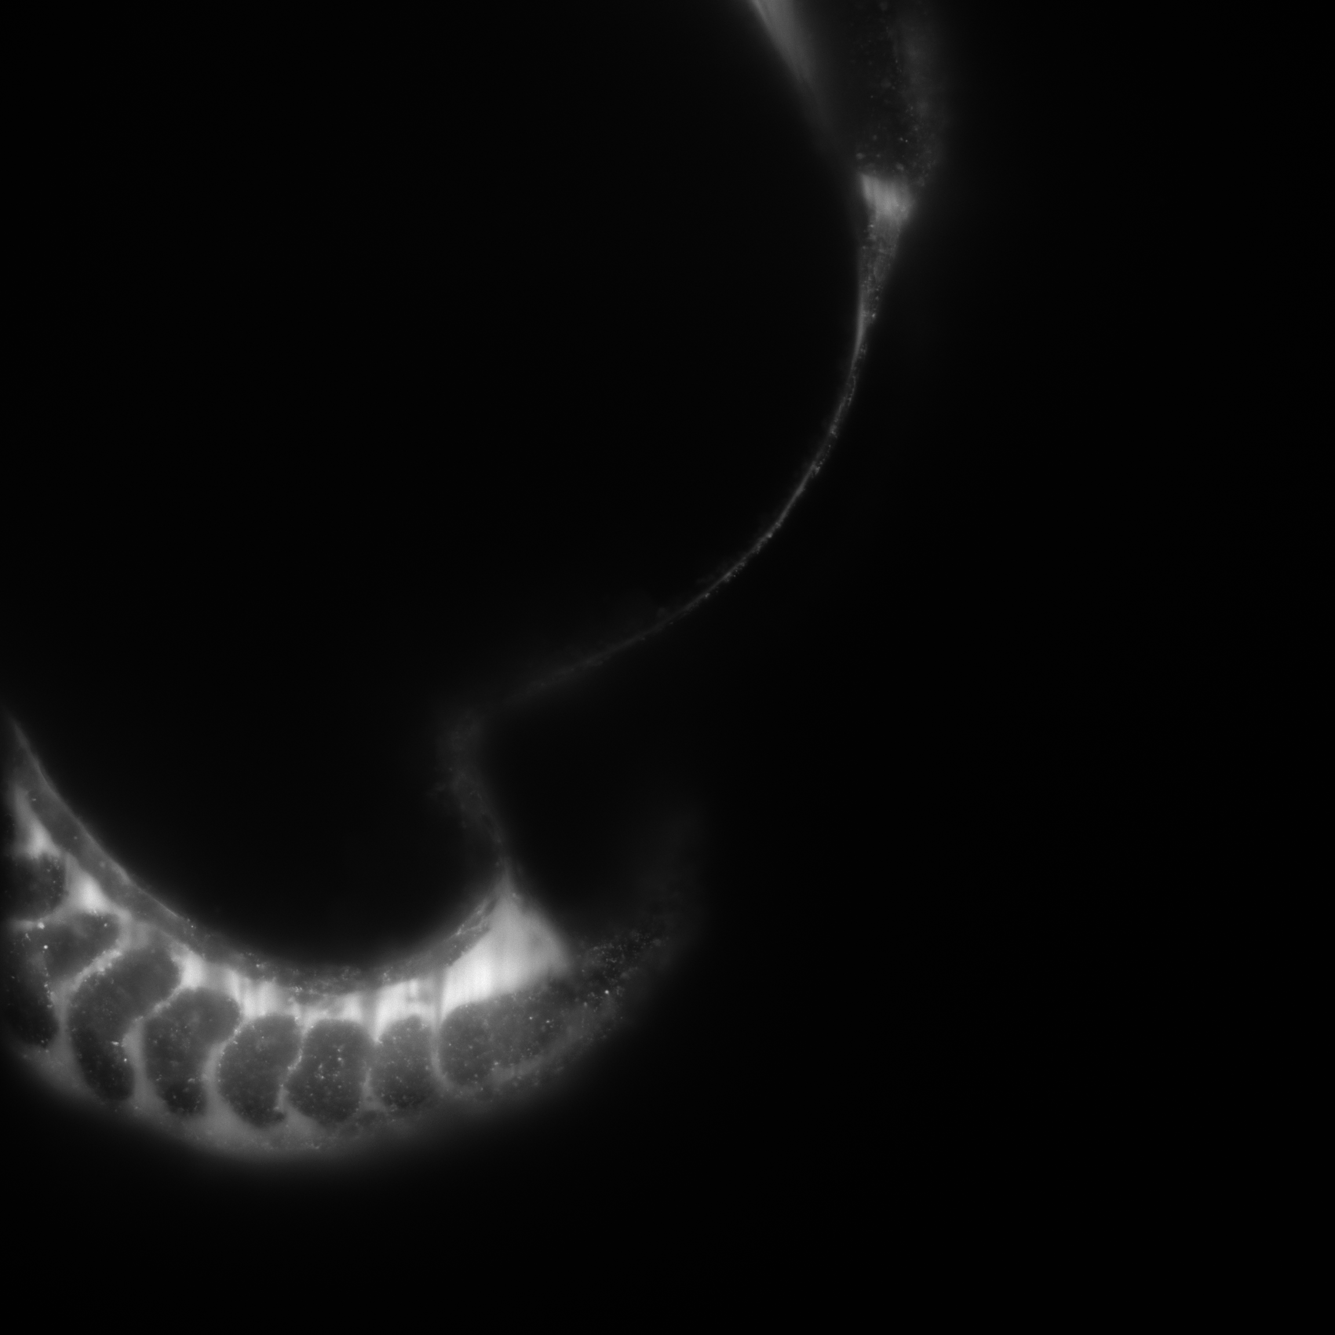

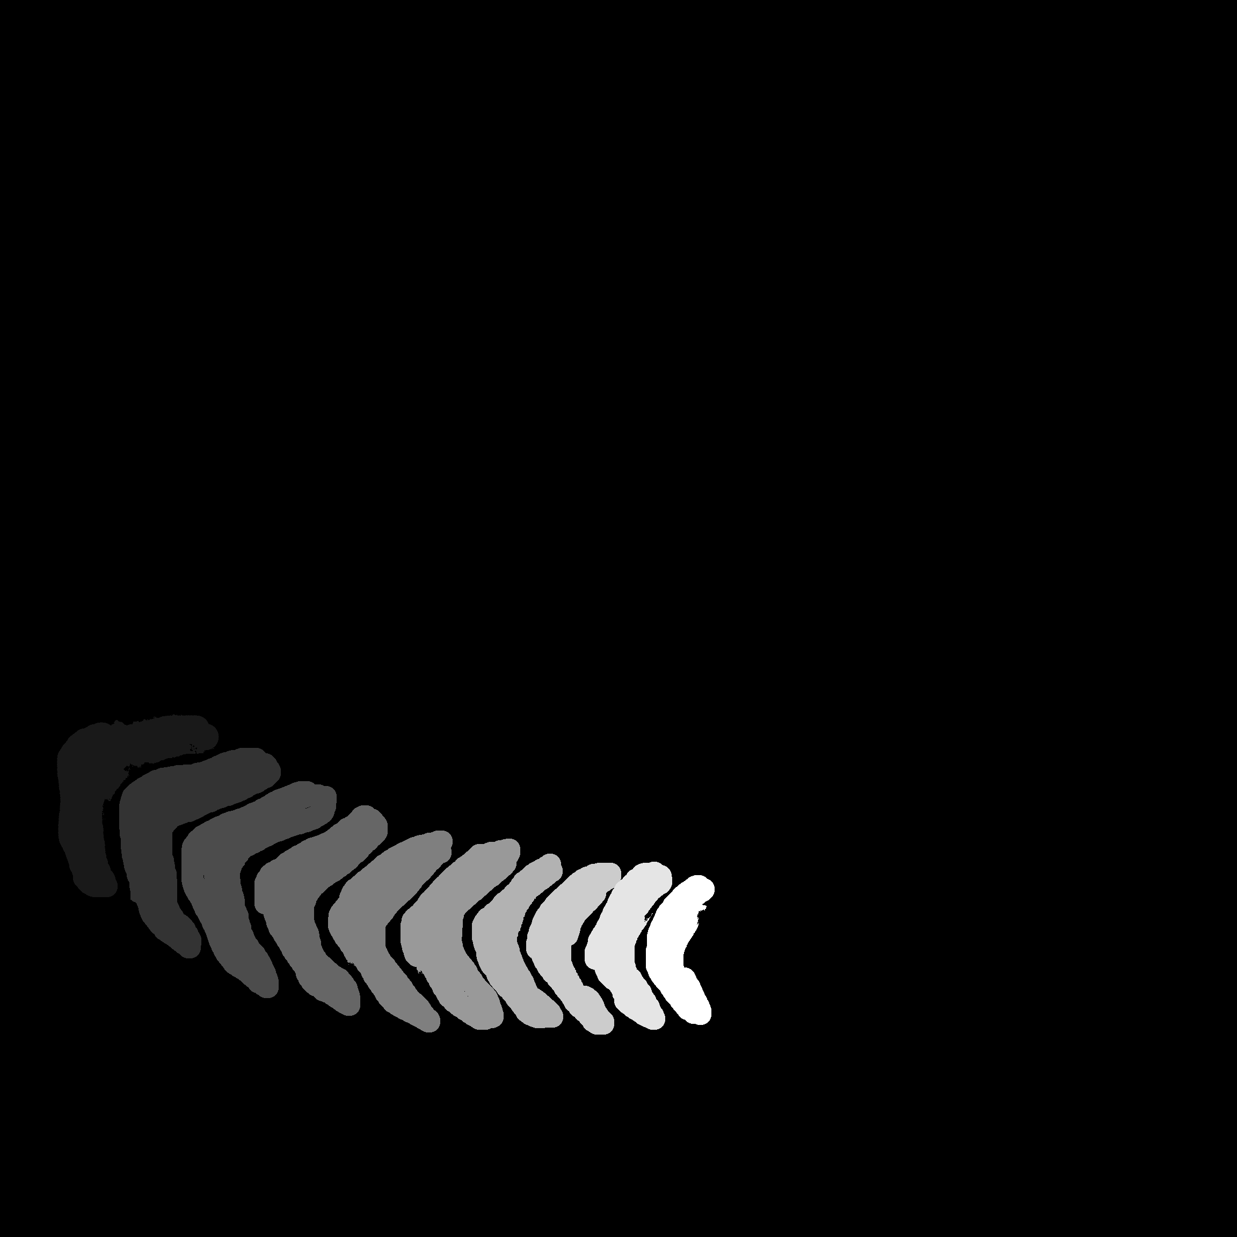
Methodology
Raw Data Adaptation
Before Pixel Conversion
After Pixel Conversion
180° Rotation Around Middle
Horizontal Axis
Raw Mask
90° Rotation Around Center

Slide 12
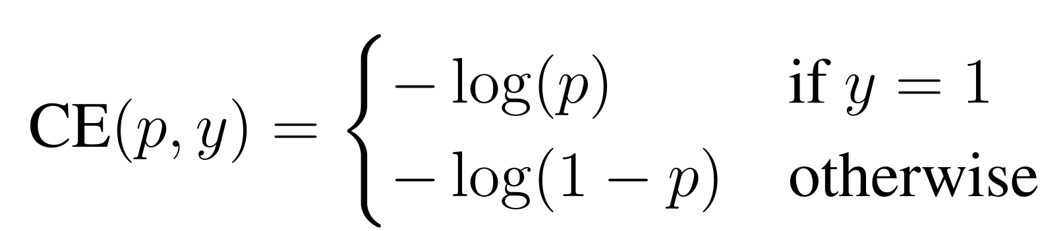
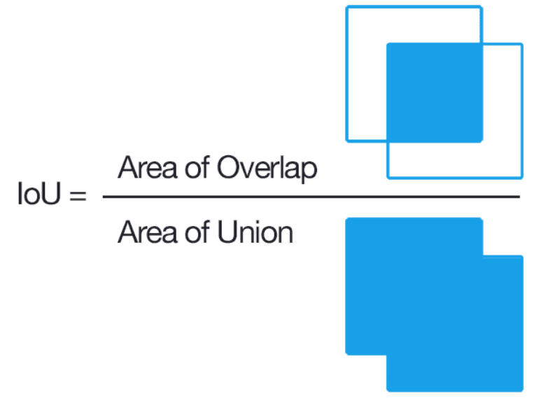
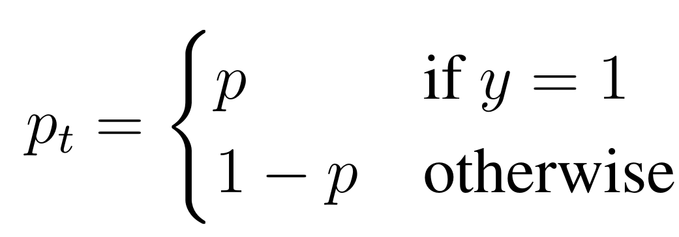
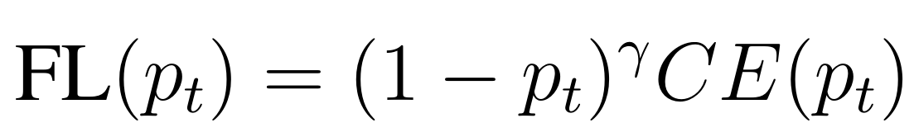
Methodology
Loss Function & Evaluation Metrics
Evaluation Metric : Intersection over Union (IoU) [7]
Loss Function : Focal Loss [3]

Slide 13
Results

Slide 14
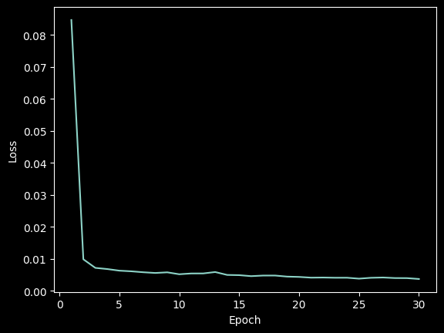
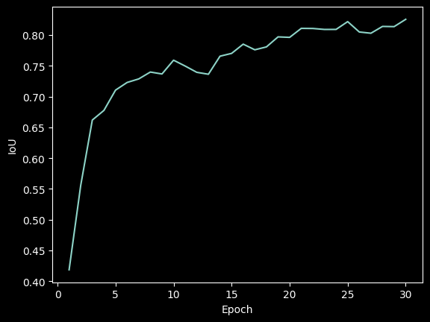
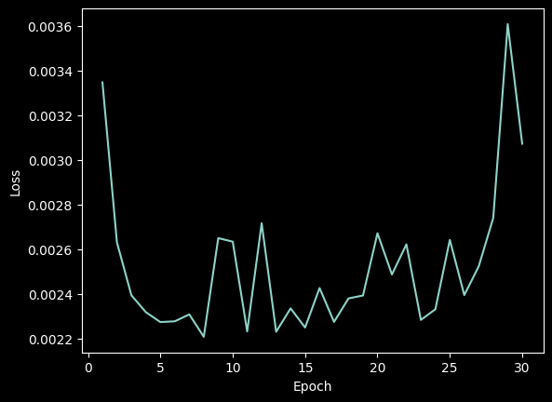
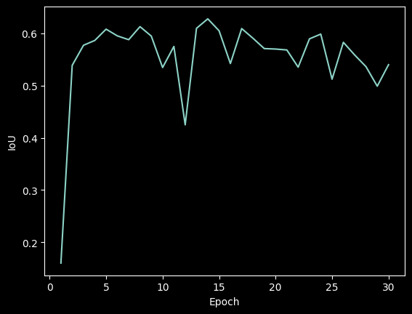
Results
Finetuning SAM – Version : facebook/sam-vit-base (93.7M)
Train Loss
Train IoU
Test Loss
Test IoU

Slide 15
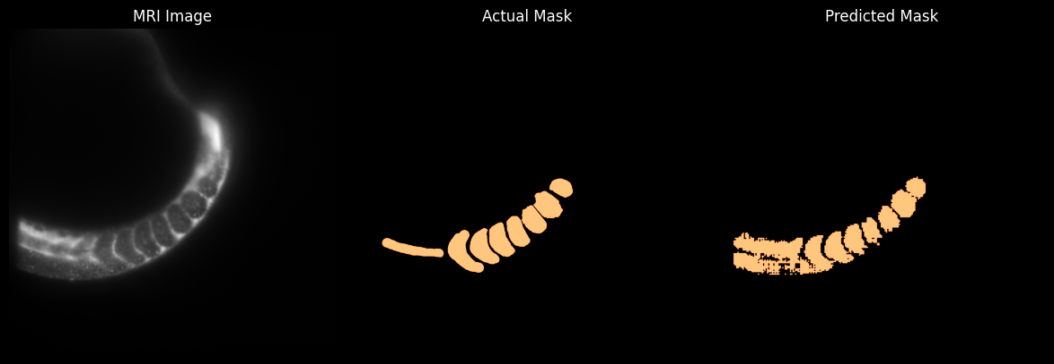
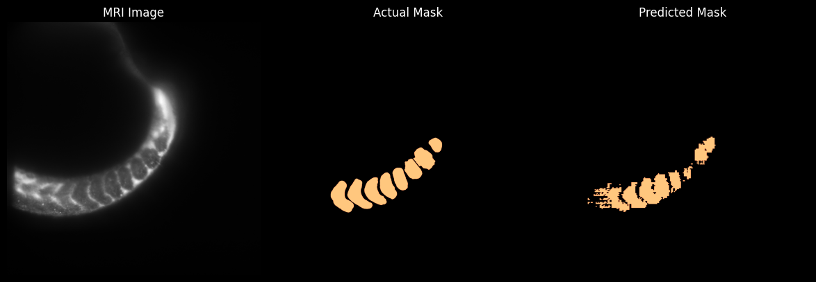
Results
Finetuning SAM – Version : facebook/sam-vit-base (93.7M)

Slide 16
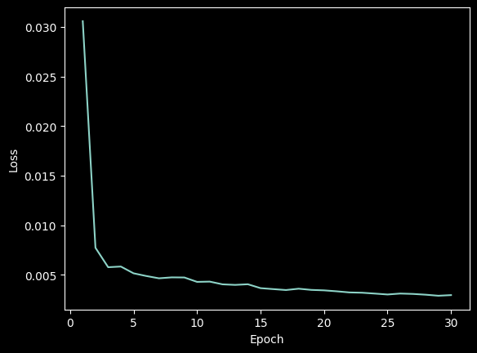
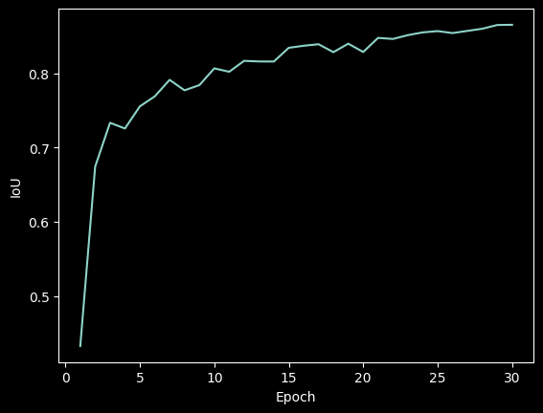
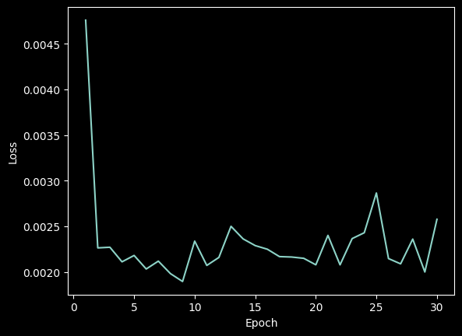
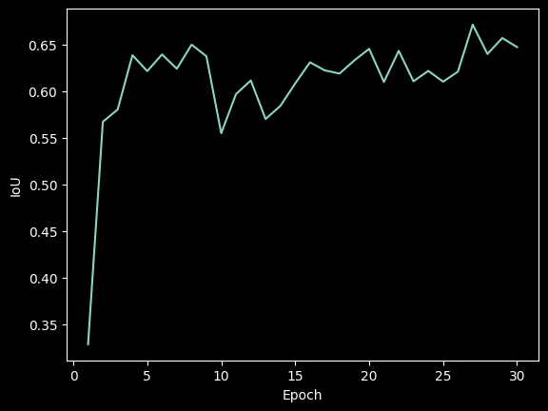
Results
Finetuning SAM – Version : facebook/sam-vit-huge (641M)
Train Loss
Train IoU
Test Loss
Test IoU

Slide 17
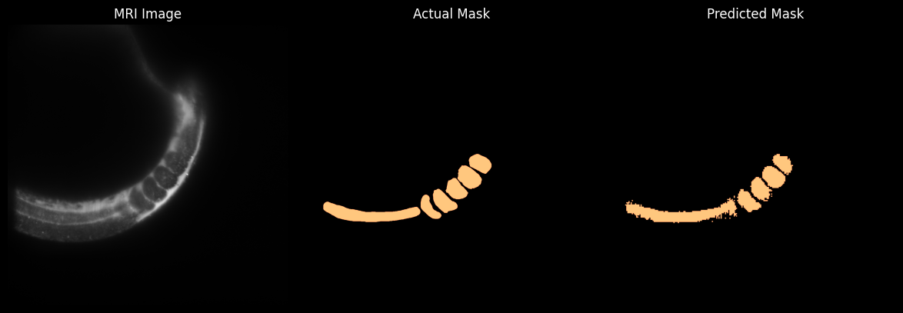
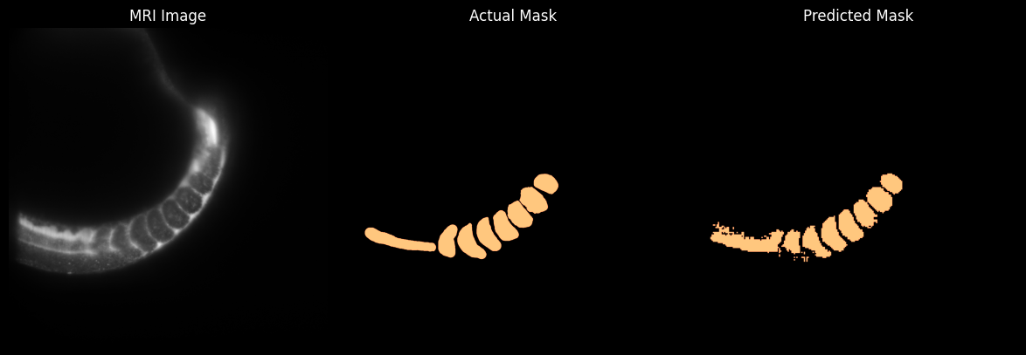
Results
Finetuning SAM – Version : facebook/sam-vit-huge (641M)

Slide 18
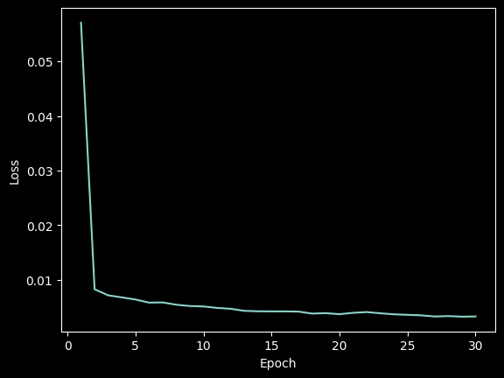
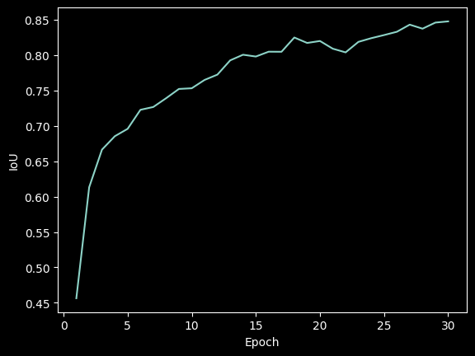
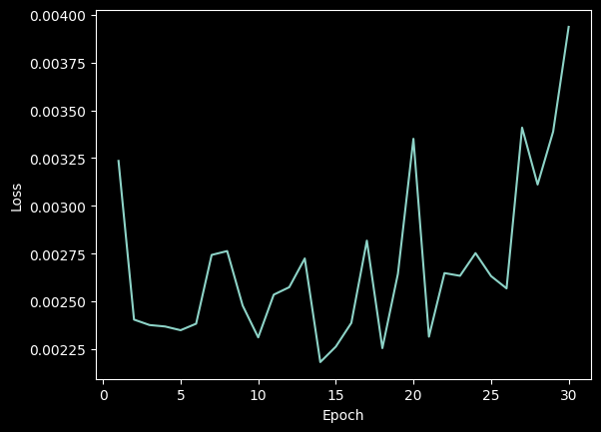
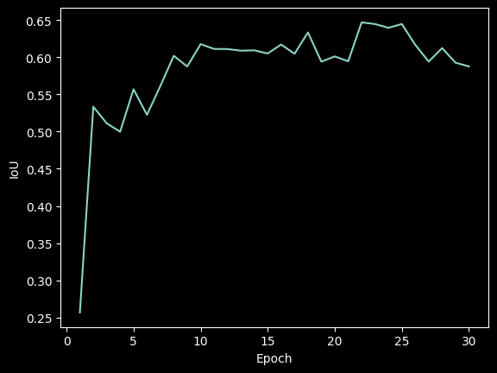
Results
Finetuning SAM – Version : wanglab/medsam-vit-base
Train Loss
Train IoU
Test Loss
Test IoU

Slide 19
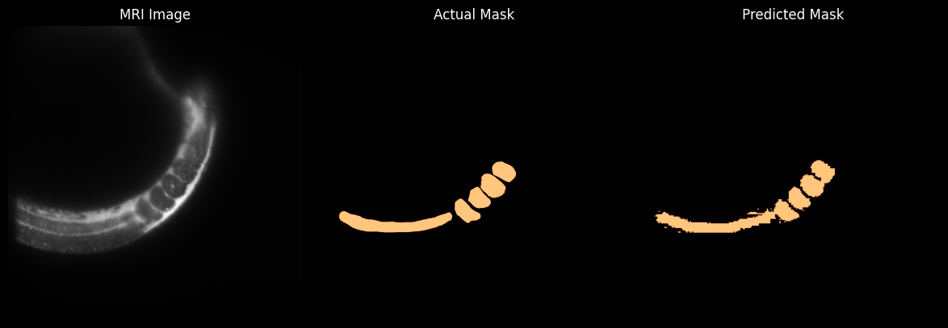
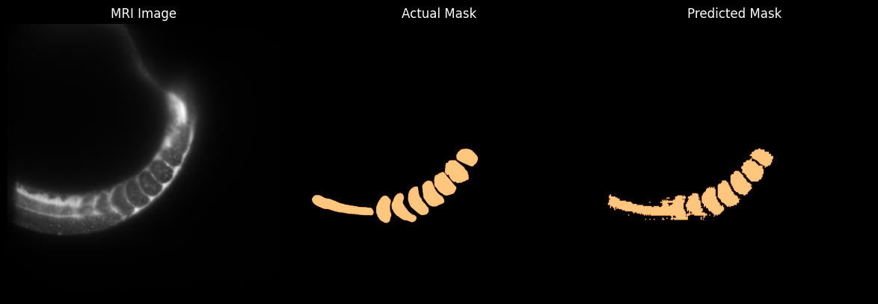
Results
Finetuning SAM – Version : wanglab/medsam-vit-base

Slide 20
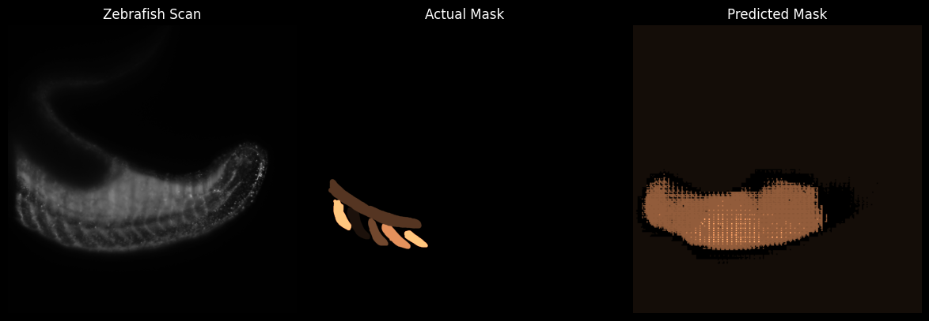
Results
Finetuning SAM – Multi-Class Image Segmentation

Slide 21
Discussion

Slide 22
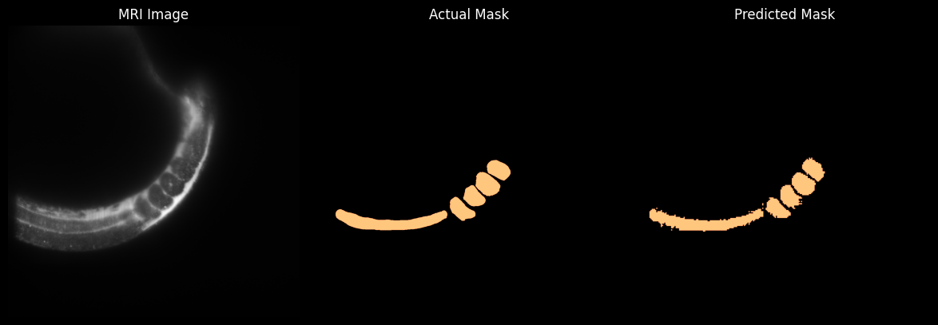

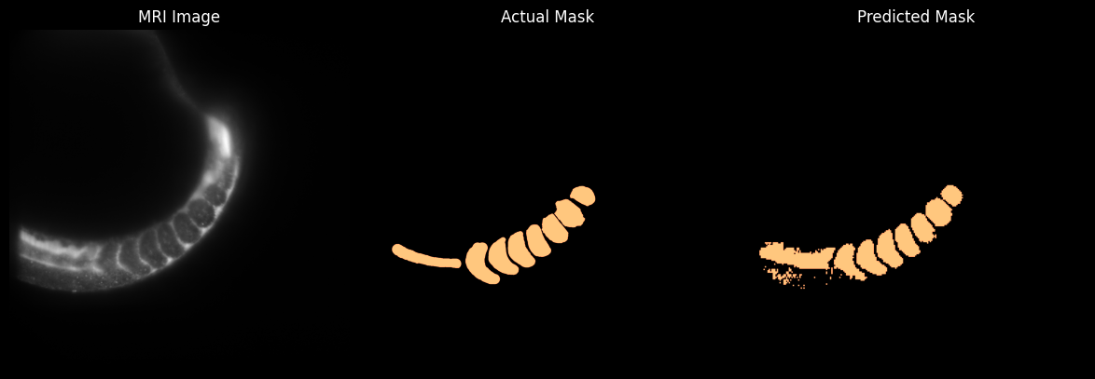
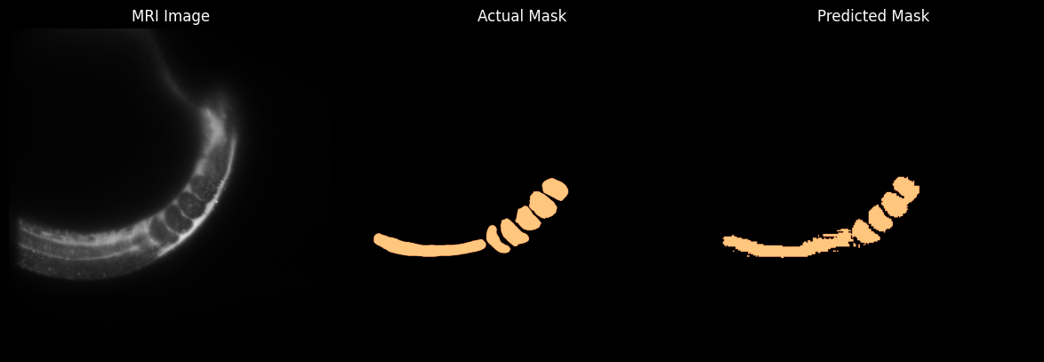
Discussion
Results Analysis – Which Model Yields The Better Results?
facebook/sam-vit-huge Model inferences
wanglab/medsam-vit-base Model inferences

Slide 23
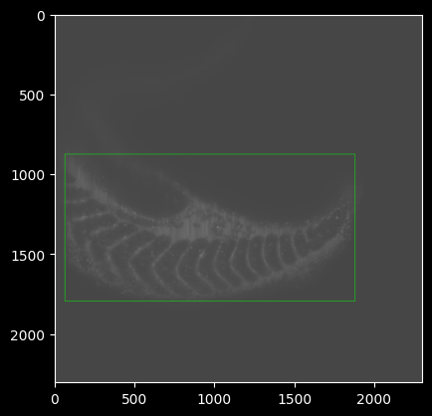
Discussion
Drawbacks of SAM & Potential Improvements
Prompt Bounding Box Example
Improvements List :
Hyperparameter Search
Multi-Class Segmentation Fix
Data Augmentation & Improvements

Slide 24
Summary & Conclusion

Slide 25
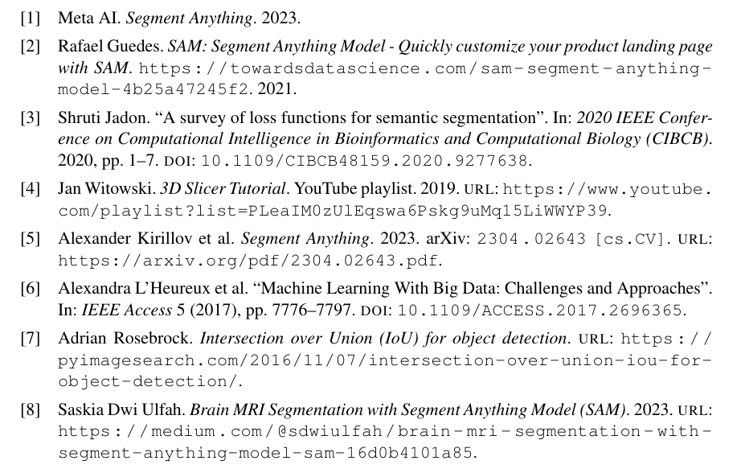
References

Slide 26
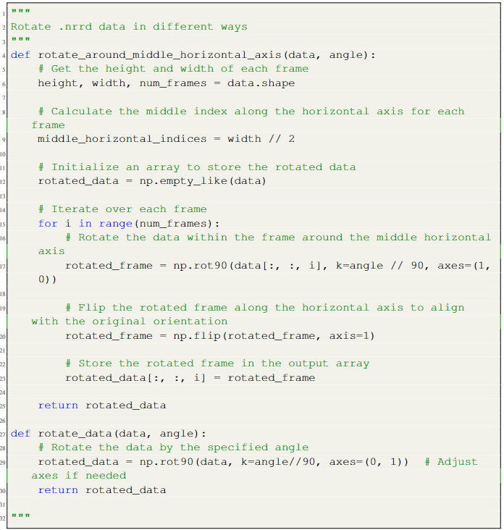
Appendix
Python Functions that Allow Proper Mask Rotation

Slide 27
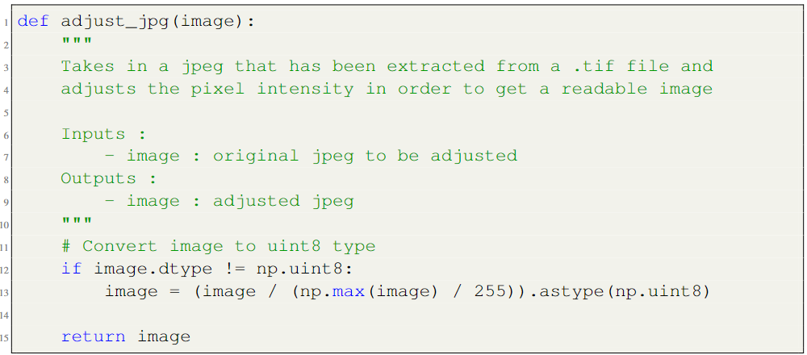
Appendix
Python Function that Allows .tif Pixel Value Conversion

Slide 28
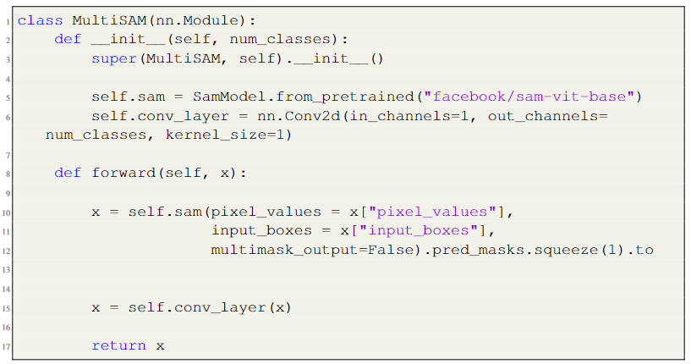
Appendix
Python Code for Multi-Class SAM Model

